Slide 2
Black Friday Analysis Using
Machine Learning
Major Project 2
Presented by:- AASHISH KUMAR
ARYAN TAYAL
VISHWATEJ AJAY

Slide 3

ABSTRACT
Customer behavior refers to an individual’s buying habits, including social trends, frequency trends, and background factors influencing their decision to buy something. Businesses study customer behavior to understand their target audience and create more-enticing products and service offers.
Customer behavior doesn’t describe who is shopping in your stores, but, instead how they are shopping in your stores. It assesses factors like how frequently customers shop, which products they prefer, and how they perceive your marketing, sales, and customer service offers. Understanding these details helps businesses communicate with customers in a productive and delightful way.

Slide 4
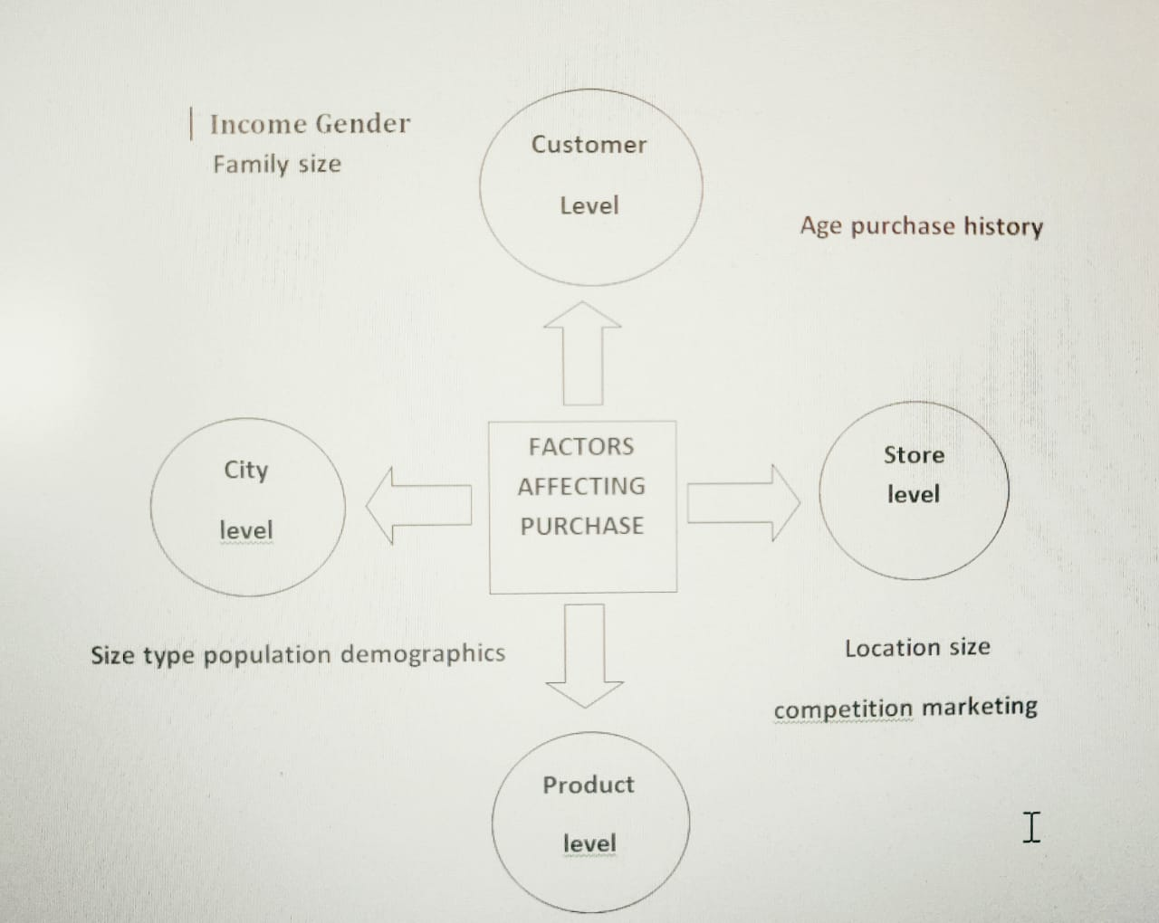
INTRODUCTION
A customer behavior analysis is a qualitative and quantitative observation of how customers interact with your company.
A customer behavior analysis provides insight into the different variables with influence an audience.
Fig.1 Factors affecting purchase

Slide 5
Problem Statement
A retail company wants to understand the customer purchase behavior against various products of different categories on the Black Friday using suitable machine learning algorithms.

Slide 6
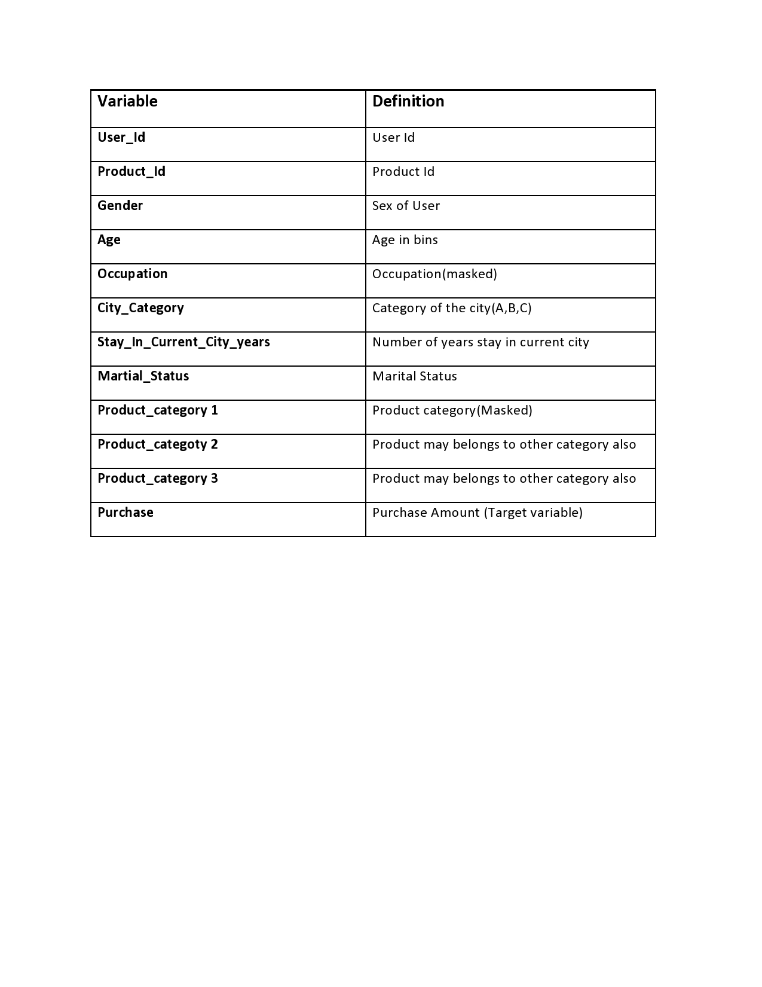
Available Data
Fig3. Available Data

Slide 7

Why Machine Learning?
Machine learning is the essential tool to analyse the data and predict the amount that a customer is likely to spent on Black Friday.

Slide 8

OBJECTIVE
The purpose of this project is to help a retail company to create the personalized offers for customers against different products.
This project also reflects the basic understanding of suitable predicting models.

Slide 9
METHODOLOGY
Our goal as a data scientist is to identify the most important variables and to define the best regression model for predicting our target variable.
Hence, this analysis is divided into five stages:-
Exploratory data analysis + preprocessing
Feature Engineering
Modelling
Hyperparameter tuning
Ensembling

Slide 10
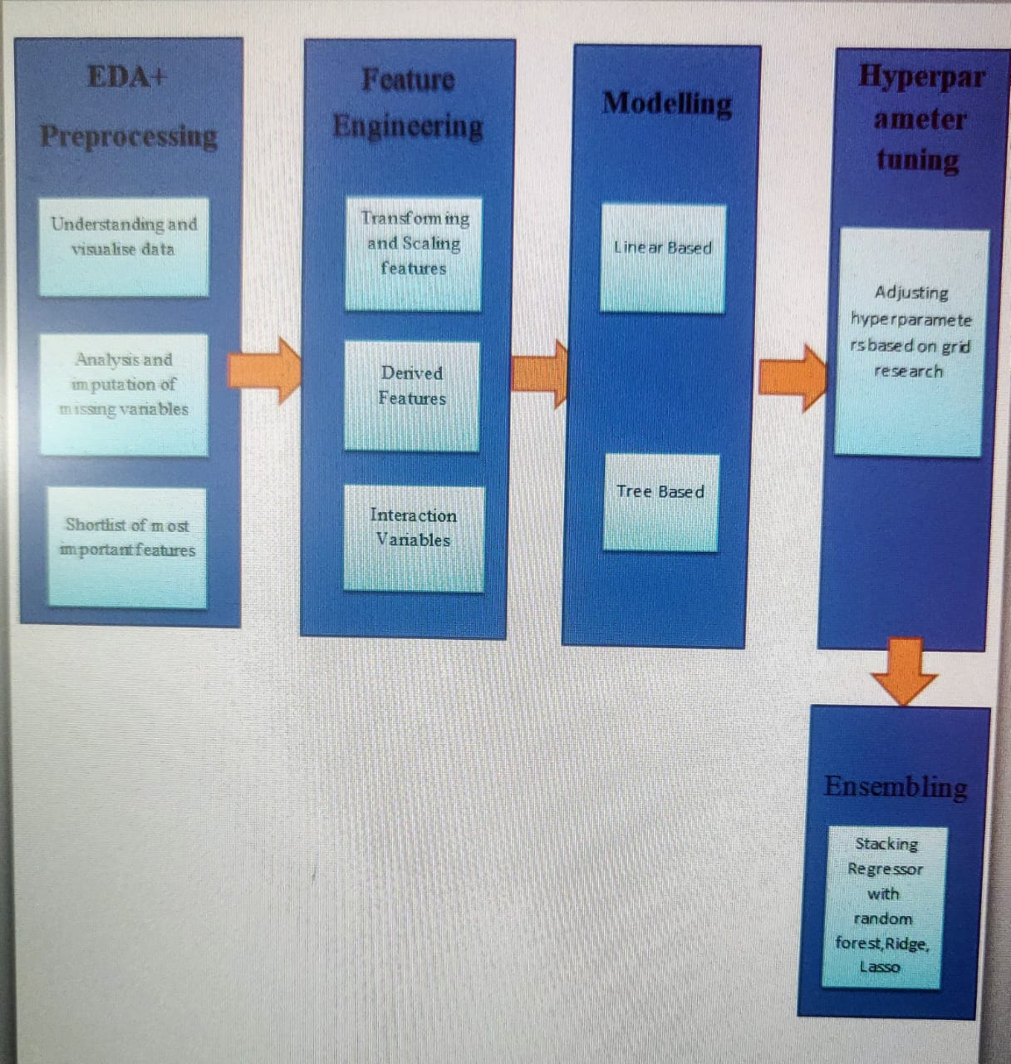
Methodology
Fig 2. steps involved in methodology

